Slide 1


“SARCASM DETECTION USING
TWITTER ANALYSIS”
D.Y. PATIL COLLEGE OF ENGINEERING, AKURDI PUNE
DEPARTMENT OF INFORMATION TECHNOLOGY
Presented By
ABUZAR TAMBOLI - B150088643
SAKSHI MORE - B150088583
SATYAM JAIMINI - B150088624
KASTURI POKHARKAR - B150088605
GANESH KARALE - B150088540
Date - 29 April, 2021

Slide 2

SARCASM DETECTION USING TWITTER ANALYSIS:
MACHINE LEARNING APPROACH

Slide 3

Under Guidance of
Mrs. AMITA JAJOO
Presented By
Abuzar Tamboli
Sakshi More
Satyam Jaimini
Kasturi Pokharkar
Ganesh Karale

Slide 4
INDEX
Abstract
Literature Survey
Introduction
System Architecture
UML Diagrams
Project Requirements
Project Plan Estimates
Implementation
Methodology
Future Scope
Advantages
Application
Conclusion
Reference

Slide 5
Abstract
Sarcasm is a sophisticated form of irony widely used in social networks and micro blogging websites. It is usually used to convey implicit information within the message a person transmits. Sarcasm might be used for different purposes, such as criticism or mockery. Twitter became one of the biggest web destinations for people to express their opinions, share their thoughts and report real-time events.

Slide 6
Problem Statement
The purpose is to find an efficient way to detect sarcastic tweets, and study how to use this information (i.e., whether the tweet is sarcastic or not) to enhance the accuracy of sentiment analysis.
To detect sarcastic comments/statements from large text data.
Sarcasm turns into social violence on social media platform.

Slide 7
LITERATURE SURVEY

Slide 8
Review of Automatic Sarcasm Detection
- Shalini Raghav , Ela Kumar, 2017
Description -
Sentiment Analysis has become a significant research matter for its probable in tapping into the vast amount of opinions generated by the people. Sentiment analysis deals with the computational conduct of opinion, sentiment within the text.

Slide 9
2. A Pattern-Based Approach for Sarcasm Detection on Twitter
- MONDHER BOUAZIZI AND TOMOAKI OTSUKI, 2018
Description -
Sarcasm is a sophisticated form of irony widely used in social networks and
microblogging websites. It is usually used to convey implicit information
within the message a person transmits. Sarcasm may be used for different
purposes,such as criticism or mockery.

Slide 10
3. Automatic Sarcasm Detection: A Survey
- ADITYA JOSHI, PUSHPAK BHATTACHARYYA, 2018
Description -
Automatic sarcasm detection is the task of predicting sarcasm in text. This is a crucial step to sentiment analysis, considering prevalence and challenges of sarcasm in sentiment-bearing text. Beginning with an approach that used speech-based features , automatic sarcasm detection has witness dgreatint from these sentiment analysis community.

Slide 11
INTRODUCTION
Sarcasm is a special type of sentiment which have the ability to flip the polarity of the given text. The main aim of sentiment analysis is to identify the polarity (positive, negative or neutral) in a given text. Sarcasm is defined as ‘the use of irony to mock or convey contempt’.
Sarcasm detection is a very narrow research field in NLP, a specific case of sentiment analysis where instead of detecting a sentiment in the whole spectrum, the focus is on sarcasm. Therefore the task of this field is to detect if a given text is sarcastic or not.

Slide 12
The goal of ‘Sarcasm Detection’ is to determine whether a sentence is sarcastic or non-sarcastic. Sarcasm is a type of phenomenon with specific perlocutionary effects on the hearer, such as to break their pattern of expectation. Consequently, correct understanding of sarcasm often requires a deep understanding of multiple sources of information, including the utterance, the conversational context, and, frequently some real world facts.
GOAL

Slide 13
OBJECTIVE
Primary objective is to analyze whether a tweet is sarcastic or not.
To identify emotional pattern.
To identify people’s intentions.

Slide 14
Existing System
Given a set of tweets, the aim is to classify each one of them depending on whether it is sarcastic or not. Therefore, from each tweet, we extract a set of features, refer to a training set and use machine learning algorithms to perform the classification. The features are extracted in a way that makes use of different components of the tweet, and covers different types of sarcasm.

Slide 15
Proposed System
A method to identify the emotional pattern and the word pattern in Twitter data to determine the changes in public opinion over the time to classify tweets based on the sentiment polarity of the users towards specific topics.

Slide 16
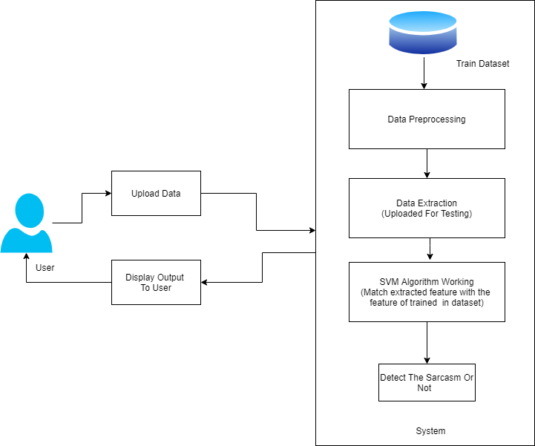
SYSTEM ARCHITECTURE
System architecture of Sarcasm Detection

Slide 17
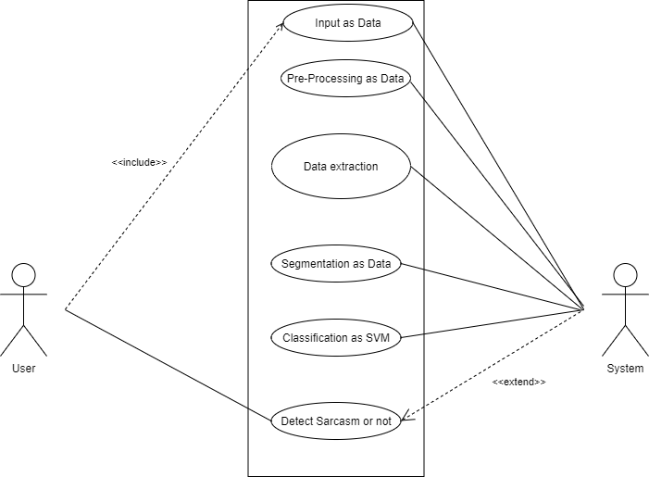
Use Case Diagram
Use case Diagram of Sarcasm Detection

Slide 18
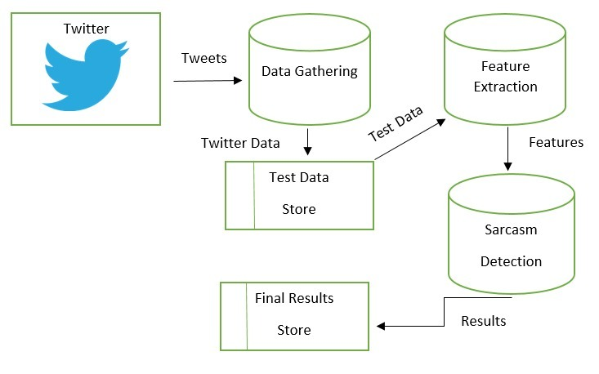
Data Flow Diagram
Data Flow Diagram of Sarcasm Detection

Slide 19
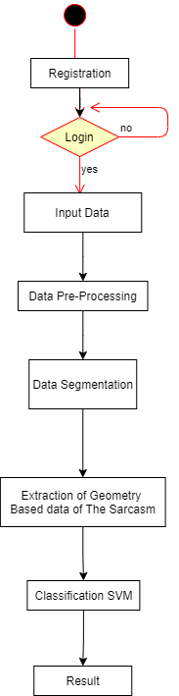
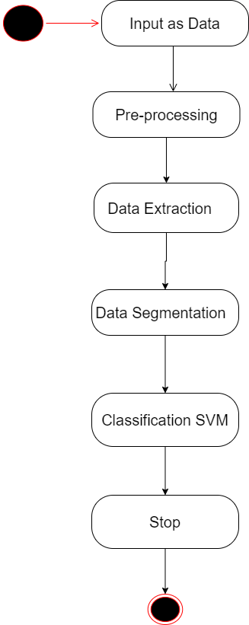
Activity Diagram State Diagram
Activity and State diagram of Sarcasm Detection

Slide 20
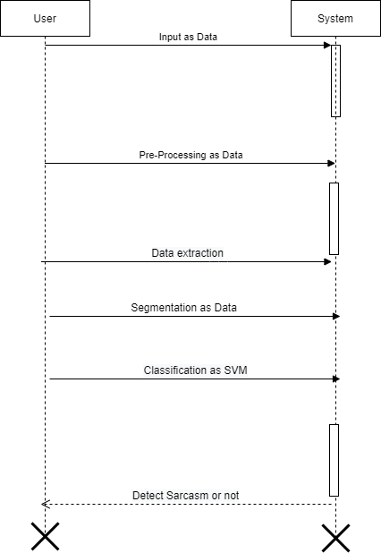
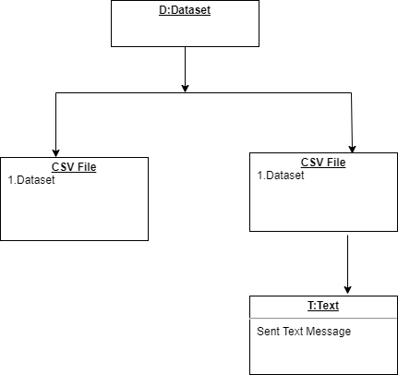
Object Diagram Sequence Diagram
Object and Sequence diagram of Sarcasm Detection

Slide 21
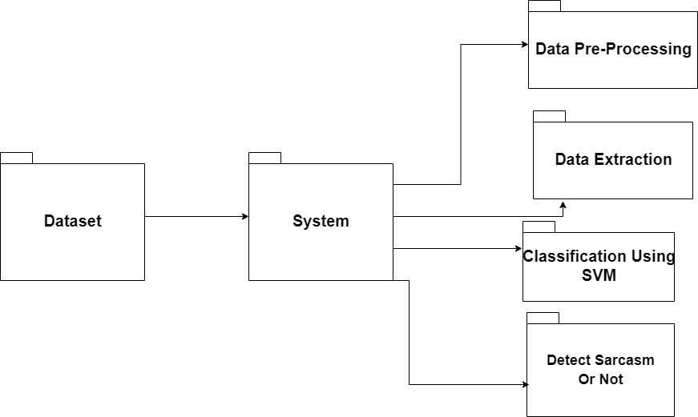
Package Diagram
Package diagram of Sarcasm Detection

Slide 22
Project Requirements
EXTERNAL INTERFACE REQUIREMENTS:
Hardware Requirement
RAM : 8 GB
As we are using Machine Learning Algorithm and Various High Level Libraries
RAM minimum required is 8 GB.
Hard Disk : 40 GB
Data Set of CT Scan images is to be used hence minimum 40 GB Hard Disk memory is required.
Processor : Intel i5 Processor

Slide 23
Anaconda IDE that Integrated Development Environment is to be used and data loading
should be fast hence Fast Processor is required
IDE : Anaconda
Best Integrated Development Environment as it gives possible suggestions at the
time of typing code snippets that makes typing feasible and fast.
Coding Language : Python Version 3.5
Highly specified Programming Language for Machine Learning because of availability
of High Performance Libraries.
Operating System : Windows 10
Latest Operating System that supports all type of installation and development Environment

Slide 24
Methodology
In testing tweets we were adopted a algorithmic process as, when we are testing tweets in each classifier if any one of the four classifier declares it as sarcastic tweet then that tweet further considered as sarcastic without considering other classifiers result. With this process the accuracy level was increased.
MODELS:
Support Vector Machine.
Neural Networks.

Slide 25
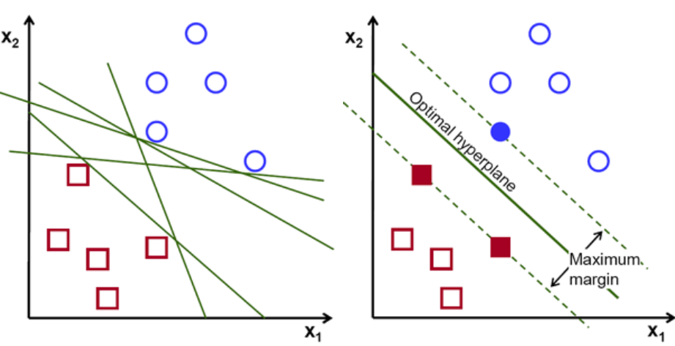
Algorithm 1 :
Support Vector Machine
The objective of the support vector machine algorithm is to find a hyperplane in an N-dimensional space(N — the number of features) that distinctly classifies the data points.

Slide 26

Possible hyperplanes
To separate the two classes of data points, there are many possible hyperplanes that could be chosen. Our objective is to find a plane that has the maximum margin, i.e the maximum distance between data points of both classes. Maximizing the margin distance provides some reinforcement so that future data points can be classified with more confidence.
Hyperplanes and Support Vectors
A Support Vector Machine (SVM) performs classification by finding the hyperplane that maximizes the margin between the two classes. The vectors (cases) that define the hyperplane are the support vectors.

Slide 27
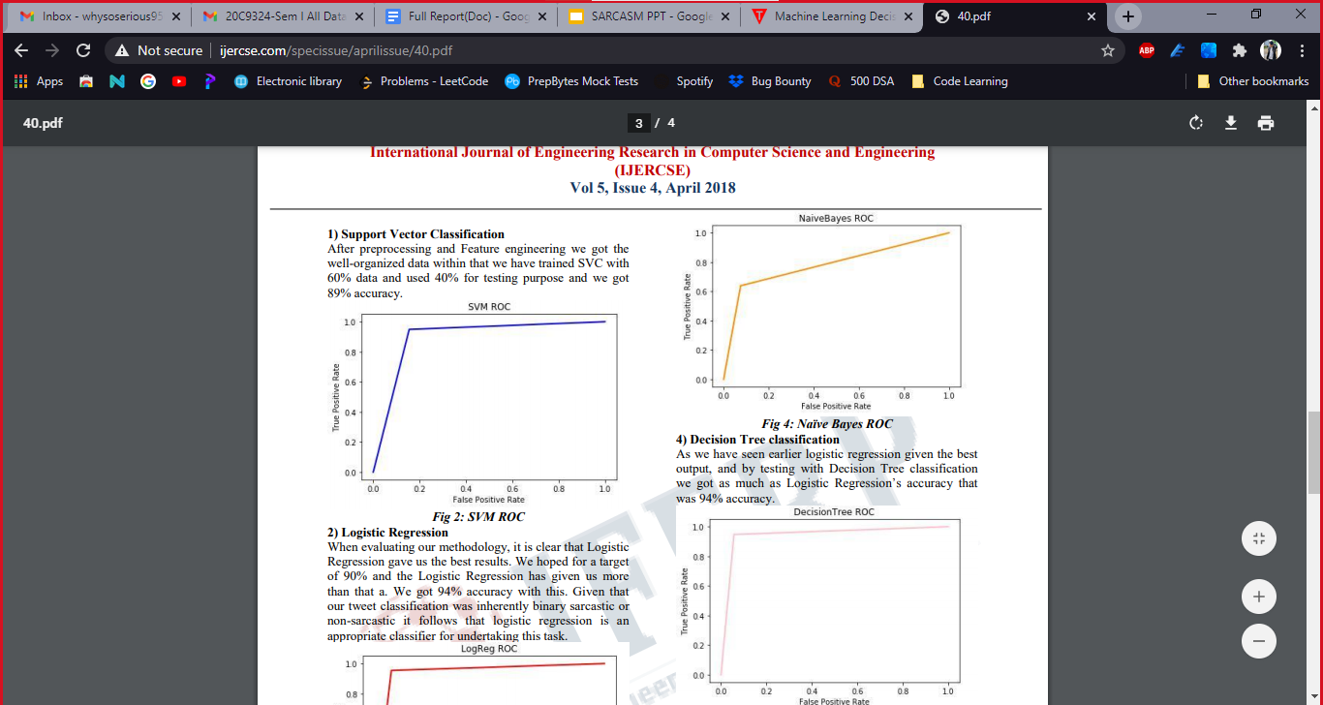
After preprocessing and Feature engineering we got the well-organized data within that we have trained SVM with 80% data and used 20% for testing purpose and we got 80.02% accuracy.

Slide 28
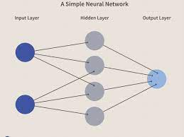
Algorithm 2 :
Neural Network
A neural network is a series of algorithms that endeavors to recognize underlying relationships in a set of data through a process that mimics the way the human brain operates. In this sense, neural networks refer to systems of neurons, either organic or artificial in nature.
Neural networks can adapt to changing input; so the network generates the best possible result without needing to redesign the output criteria. The concept of neural networks, which has its roots in artificial intelligence, is swiftly gaining popularity in the development of trading systems.

Slide 29
Model
Sentiment shifting is prevalent in sarcasm-related communication; thus, the authors propose to first train a sentiment model (based on a CNN) for learning sentiment-specific feature extraction.
The model learns local features in lower layers which are then converted into global features in the higher layers. The authors observe that sarcastic expressions are user-specific — some users post more sarcasm than others.
In the proposed framework, personality-based features, sentiment features, and emotion-based features are incorporated into the sarcasm detection framework. Each set of features are learned by separate models, becoming pre-trained models used to extract sarcasm-related features from a dataset.

Slide 30
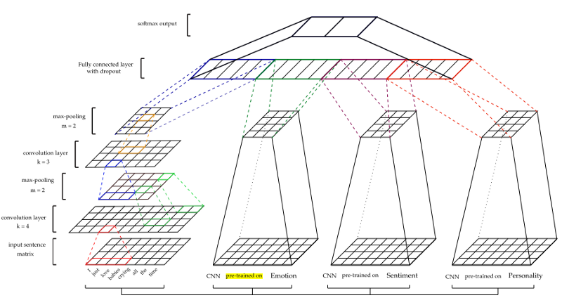
NEURAL NETWORK FRAMEWORK IN SARCASM DETECTION

Slide 31
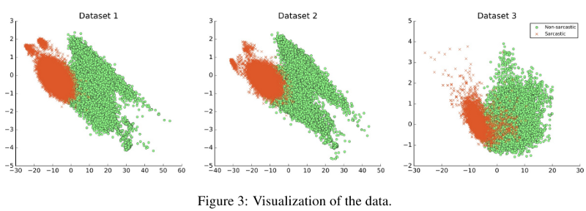
CONSISTENCY OF NEURAL NETWORK FOR DIFFERENT TRAINING DATASETS

Slide 32
MATHEMATICAL MODULE
Let S be the Whole system which consists:
S= {Twitter Dataset}.
Where,
Twitter Dataset is the input of the system.
Pro is the procedure applied to the system to classification of the given input.
OP is the output of the project to detect the people to express their opinions.
A. Input:
IP = {I}.
Where,
I is set of Twitter Dataset , provided as an input.

Slide 33
B. Procedure:
Step1: Twitter Dataset .
Step2: Verify the information into database.
Step3: Use of Part-of-Speech tags to extract patterns characterizing the level of sarcasm of tweets.
Step4: Show result.
C. Output:
To detect the people to express their opinions

Slide 34
Advantages
Sarcasm is complex enough to give humans a hard time understanding it, let alone by machines.Punctuations used in a sentence plays a huge role in detecting if what is being said is sarcastic or not, because the way we say or write something can dramatically change the meaning of it.
Major misunderstanding which occurs due to misinterpretation of a comment can be detected.
Social media and web applications are common platforms for sarcastic comments and would attract individuals or organizations who are keen to know who is talking what about people’s opinion regarding them.

Slide 35
Conclusion
Our system uses combined approach of different methods like emotion detection, use of emoticons, patterns, etc. identifies the social site comment is sarcastic or not. So it is required to use combined approach which take different methods and identify the comment is sarcastic or not. The sarcasm identification model is a novel approach based on emotion model. The sarcasm identification model uses different algorithms, libraries
And methods in emotion detection phase and its result is used for sarcasm detection.The proposed method makes use of the different components of the tweet. Our approach makes use of Part-of-Speech tags to extract patterns characterizing the level of sarcasm of tweets.

Slide 36
References
[1] J. M. Soler, F. Cuartero, and M. Roblizo, ``Twitter as a tool for pre- dicting elections results,'' in Proc. IEEE/ACM ASONAM, Aug. 2012, pp. 1194_1200.
[2] S. Homoceanu, M. Loster, C. Lo_, and W.-T. Balke, ``Will I like it? Providing product overviews based on opinion excerpts,'' in Proc. IEEE CEC, Sep. 2011, pp. 26_33.
[3] U. R. Hodeghatta, ``Sentiment analysis of Hollywood movies on Twitter,'' in Proc. IEEE/ACM ASONAM, Aug. 2013, pp. 1401_1404.
[4] R. L. J. Brown, ``The pragmatics of verbal irony,'' in Language Use and the Uses of Language. Washington, DC, USA: Georgetown University Press, 1980, pp. 111_127.

Slide 37
[5] S. Attardo, ``Irony as relevant inappropriateness,'' in Irony in Language and Thought. New York, NY, USA: Psychology Press, Jun. 2007, pp. 135_ 174.
[6] R. W. Gibbs, Jr., and J. O'Brien, ``Psychological aspects of irony understanding,'' J. Pragmatics, vol. 16, no. 6, pp. 523_530, Dec. 1991.
[7] H. Grice, ``Further notes on logic and conversation,'' in Pragmatics: Syntax and Semantics. San Diego, CA, USA: Academic, 1978, pp. 113_127.
[8] O. Tsur, D. Davidov, and A. Rappoport, ``ICWSM_A great catchy name: Semi-supervised recognition of sarcastic sentences in online product reviews,'' in Proc. AAAI Conf. Weblogs Soc. Media, May 2010,pp. 162_169.

